Slide 1

VisionRestore Pro :
Classical Image Restoration System
CSE 4128 : Image Processing and Computer Vision Laboratory
Supervised By:
Dr. Sk. Md. Masudul Ahsan
Professor,
Md Tajmilur Rahman
Lecturer,
Department of Computer Science and Engineering
Submitted By:
Abdullah Al Shafi
Roll: 2007055
4th Year, 1st Semester
Khulna University of Engineering & Technology

Slide 2
Contents
Introduction
Problem Statement
Objectives
Methodology
Implementation
Discussions
Conclusions
References

Slide 3
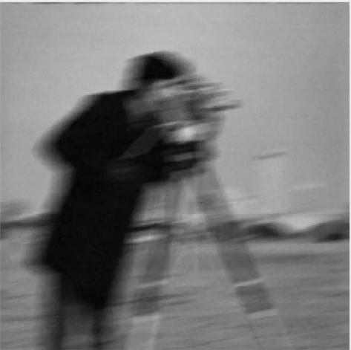
Introduction
Digital images suffer from multiple degradations.
Motion blur from camera shake
Gaussian noise in low-light conditions
Salt & pepper noise from sensor defects
Mixed artifacts in real-world scenarios
VisionRestore Pro uses classical image
processing and computer vision techniques
to restore the image

Slide 4
Problem Statements
Single-algorithm approaches fail on complex degradations
Manual parameter tuning required
No adaptive processing based on image content
Limited analysis capabilities

Slide 5
Objectives
Intelligent degradation analysis
Content-aware parameter optimization
Hybrid algorithm combination
Real-time quality assessment

Slide 6
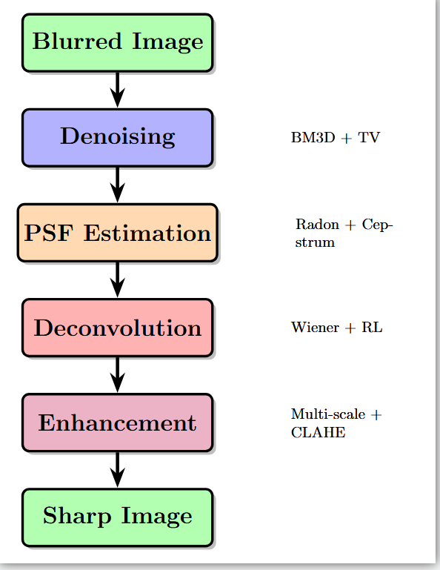
Methodology
Fig. 1: Pipeline Flowchart

Slide 7
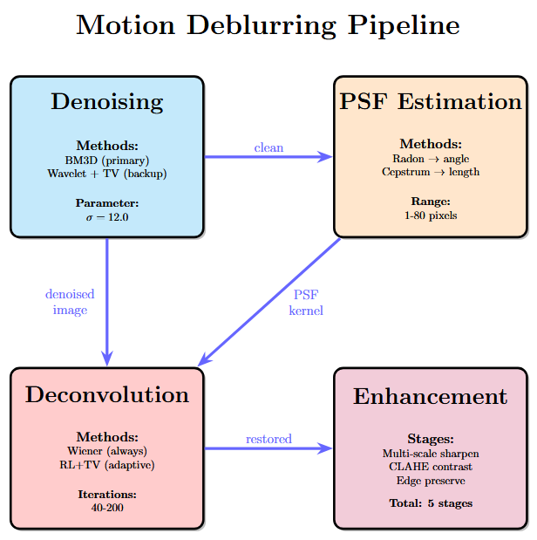
Methodology - Importance Map [major sub title]
Fig. 2: Algorithms Flowchart

Slide 8
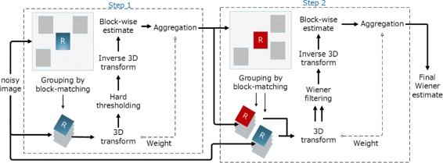
Methodology - Denoising
Fig. 3: BM3D Architecture Diagram

Slide 9
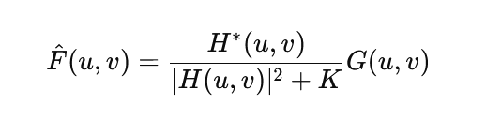
Methodology - Deblurring
The Wiener filter is a classic technique used in signal processing and image restoration
Minimizes the mean square error between an estimated signal and the original (true) signal

Slide 10
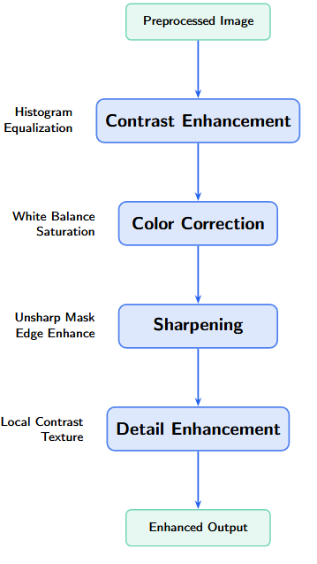
Methodology - Enhancement
Fig. 4: Enhancement Pipeline

Slide 11
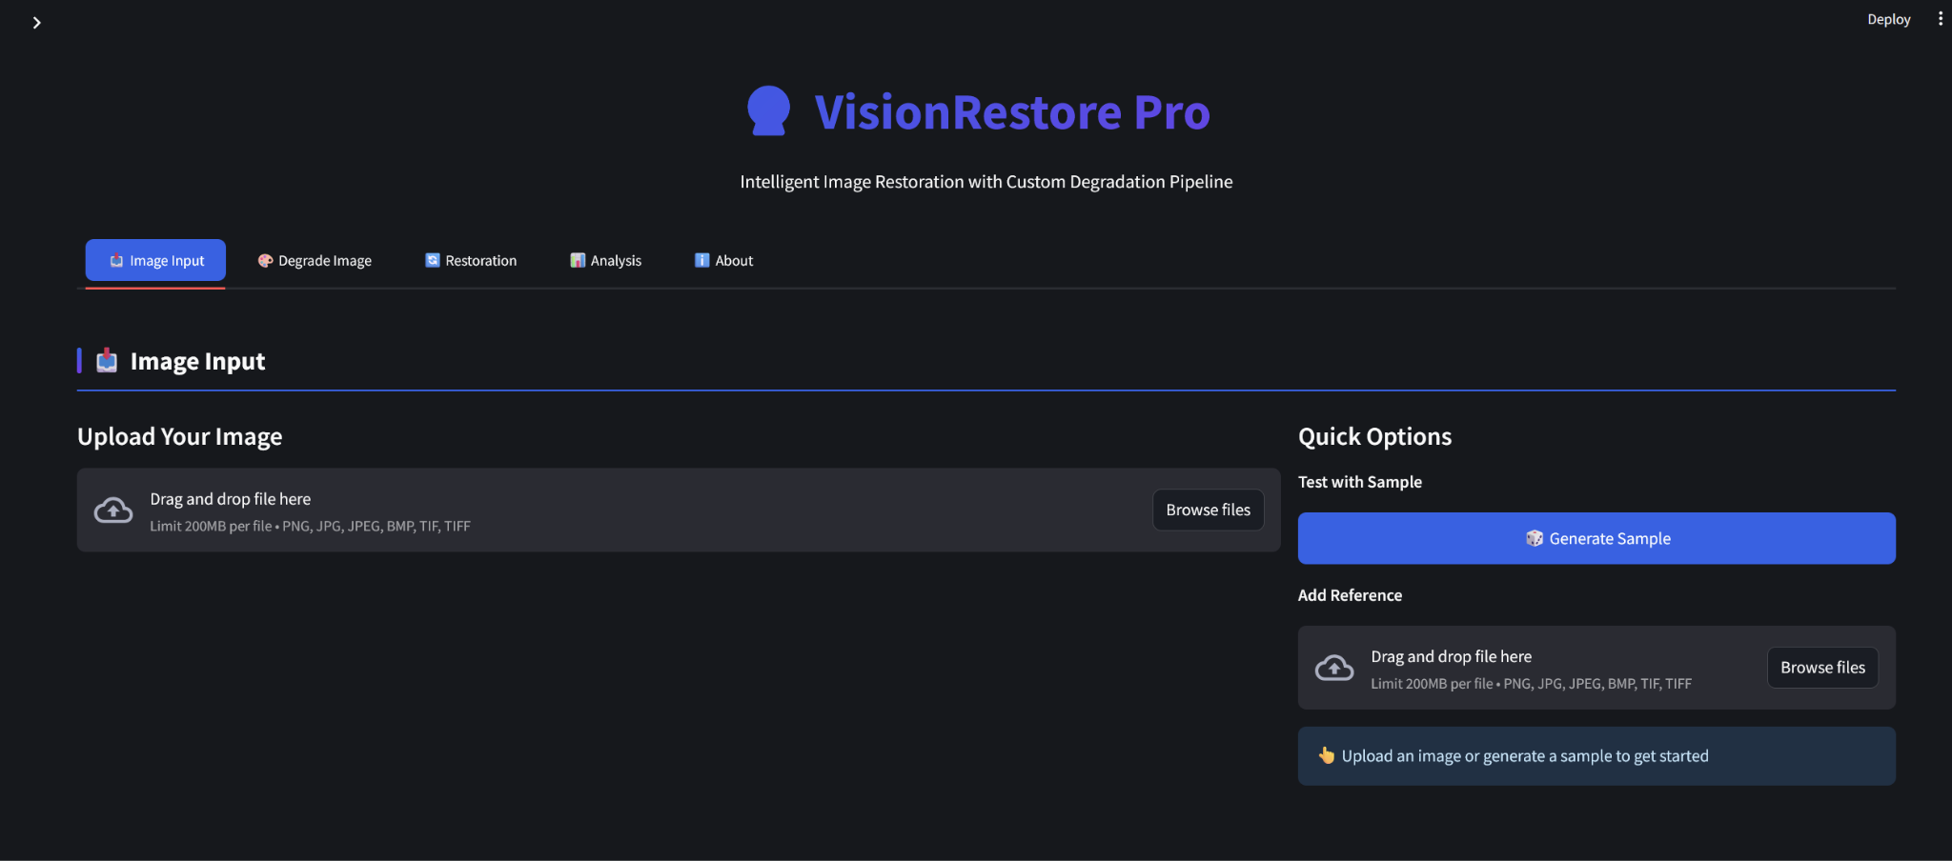
Implementation
Fig. 5: Landing Page
Notes:
Contains 1000 images with complex backgrounds and low contrast objects along with their ground truth images

Slide 12
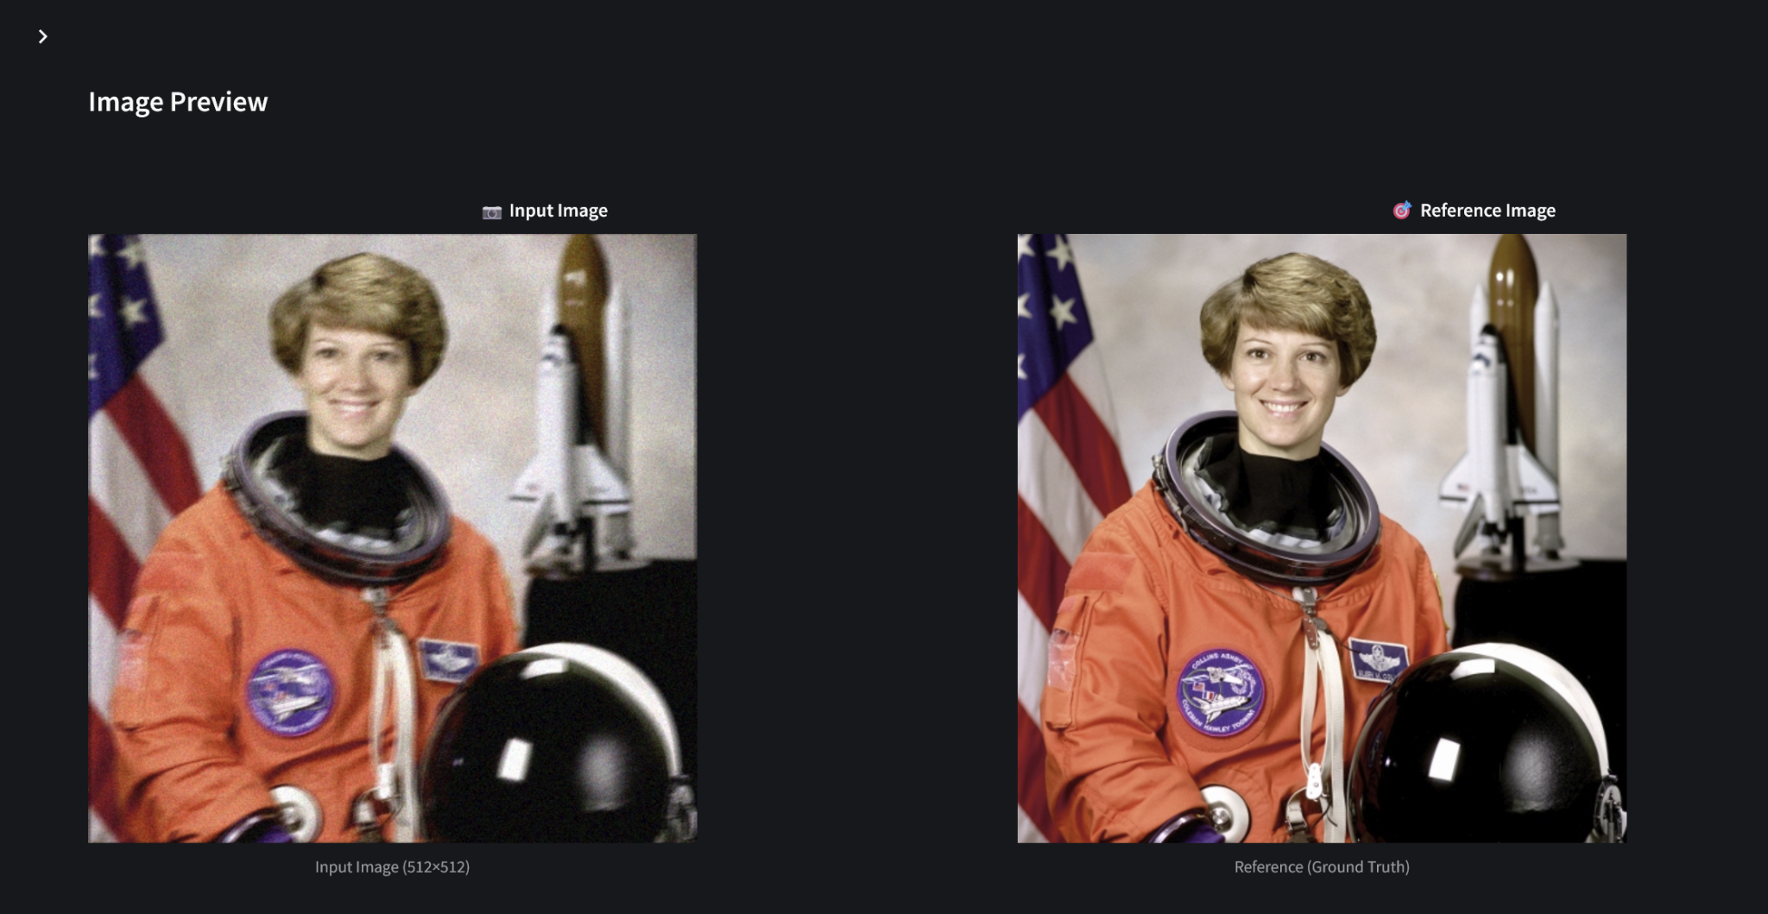
Implementation
Fig. 6: Preview
Notes:
Contains 1000 images with complex backgrounds and low contrast objects along with their ground truth images

Slide 13
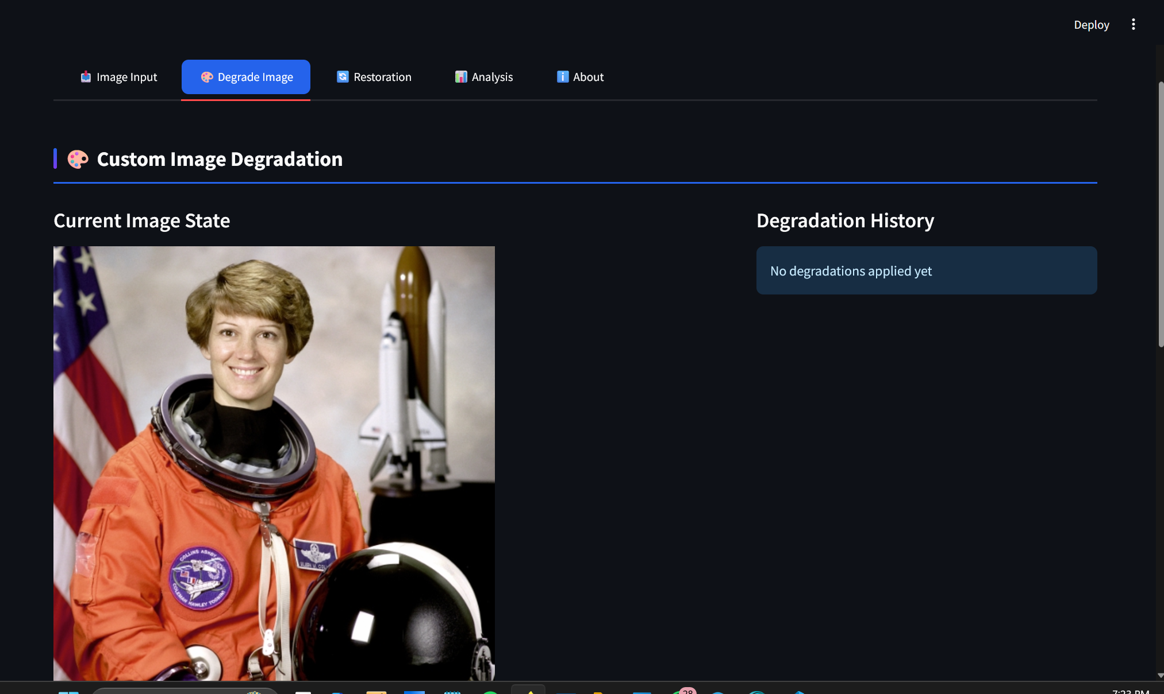
Implementation
Fig. 7: Image Degradation Page
Notes:
Contains 1000 images with complex backgrounds and low contrast objects along with their ground truth images

Slide 14
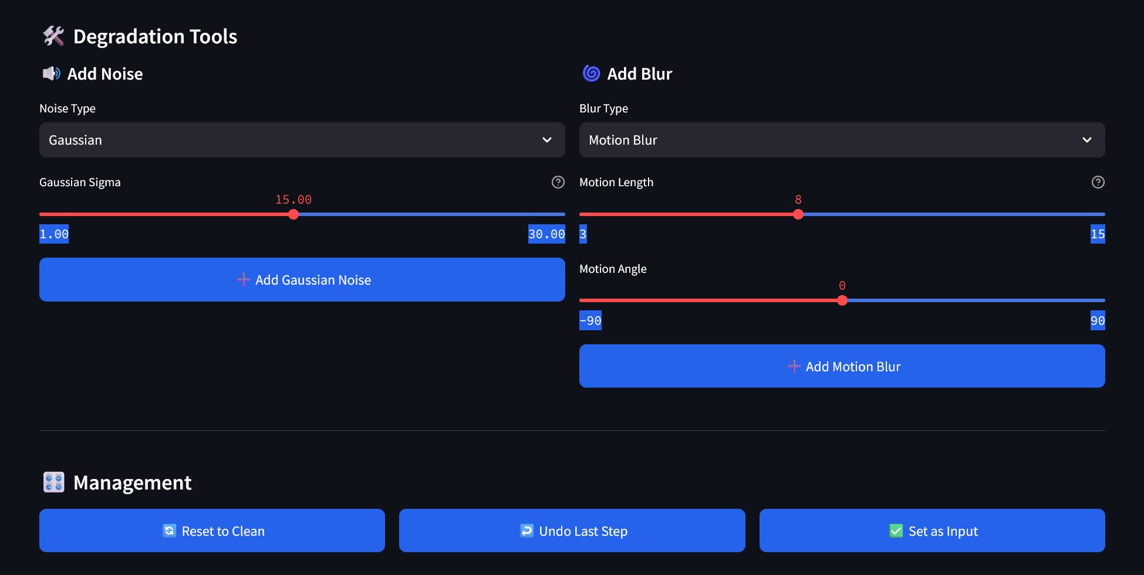
Implementation
Fig. 8: Degradation Tools
Notes:
Contains 1000 images with complex backgrounds and low contrast objects along with their ground truth images

Slide 15
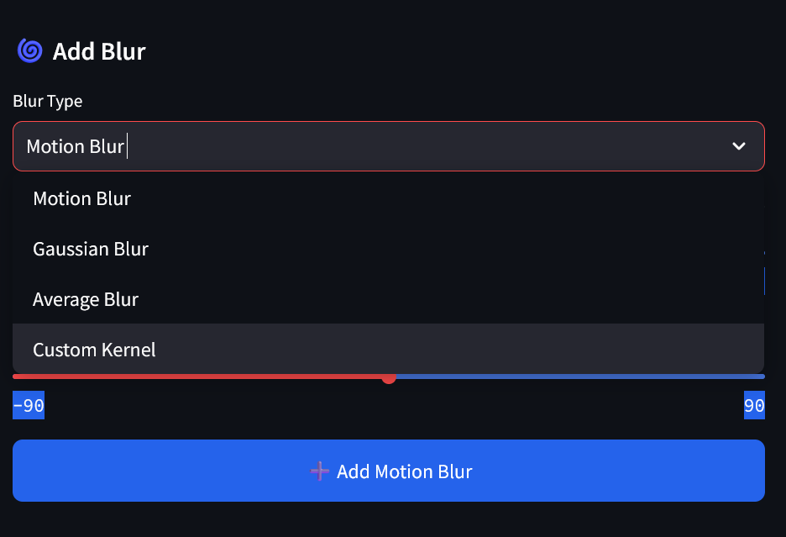
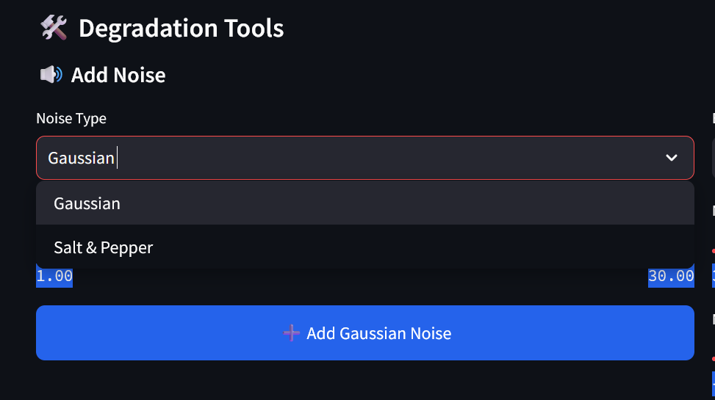
Implementation
Fig. 9: Degradation Tools
Notes:
Contains 1000 images with complex backgrounds and low contrast objects along with their ground truth images

Slide 16
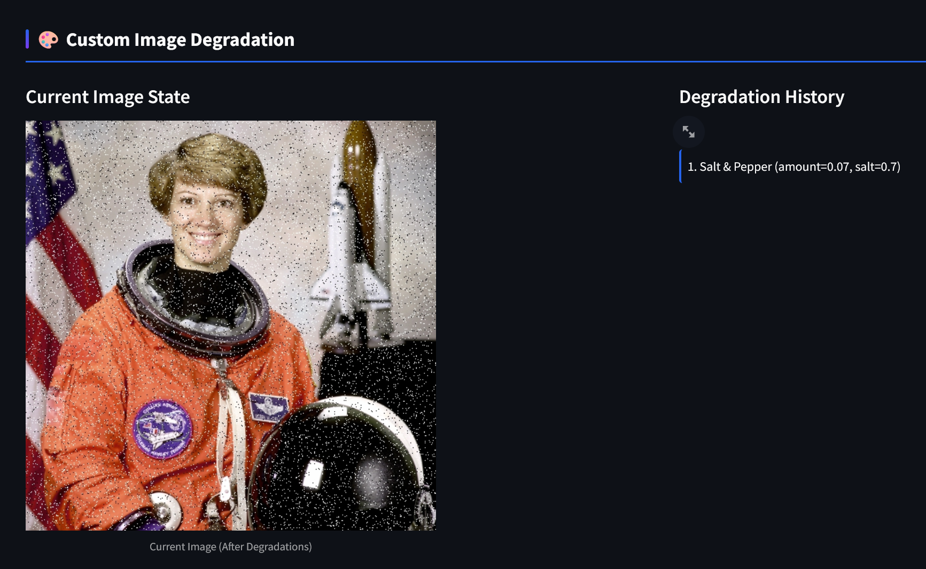
Implementation
Fig. 10: Salt & Pepper Noise Added
Notes:
Contains 1000 images with complex backgrounds and low contrast objects along with their ground truth images

Slide 17
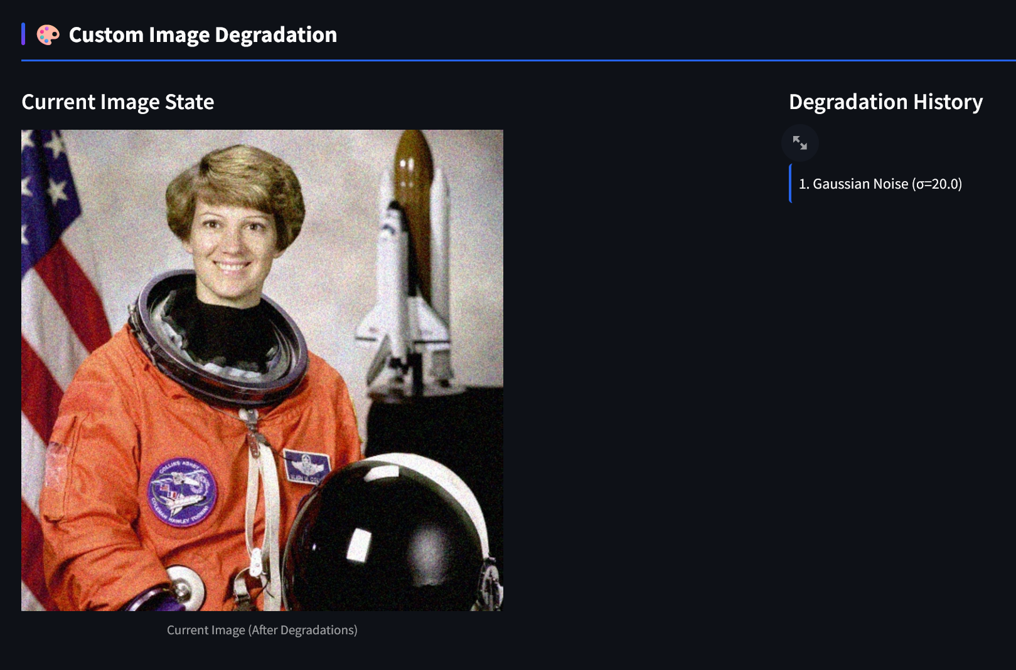
Implementation
Fig. 11: Gaussian Noise Added
Notes:
Contains 1000 images with complex backgrounds and low contrast objects along with their ground truth images

Slide 18
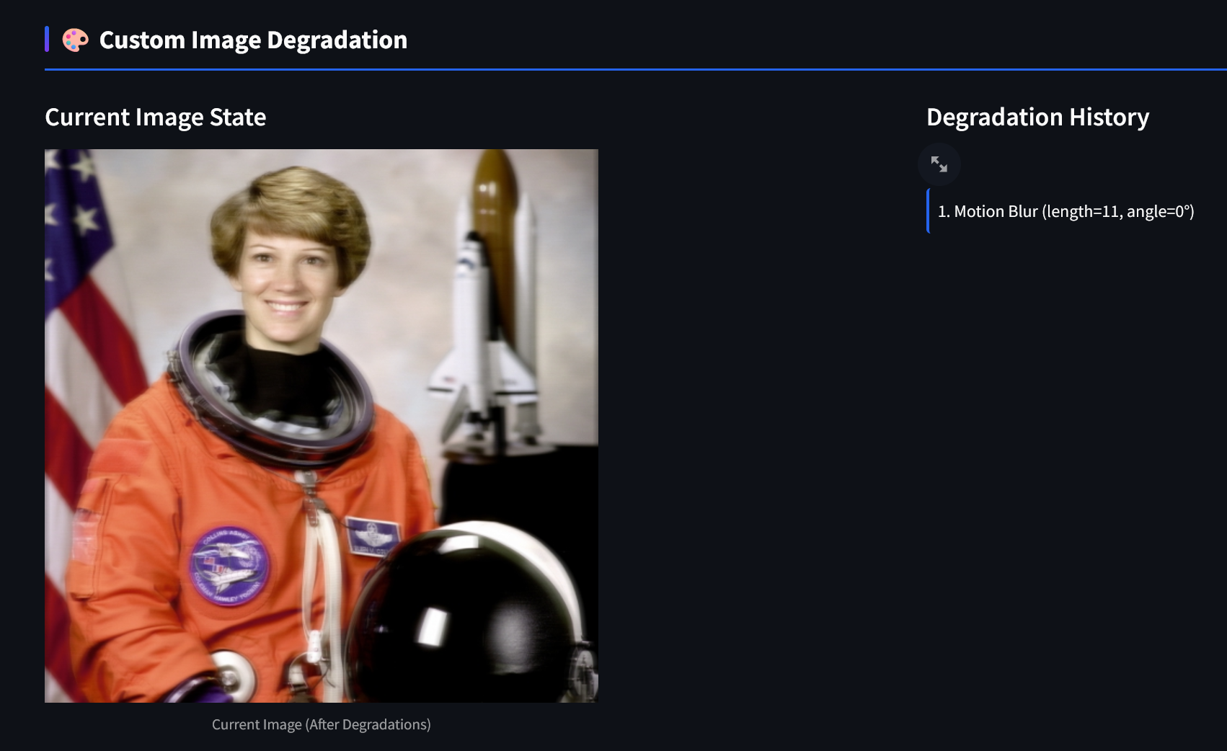
Implementation
Fig. 12: Motion Blur Added
Notes:
Contains 1000 images with complex backgrounds and low contrast objects along with their ground truth images

Slide 19
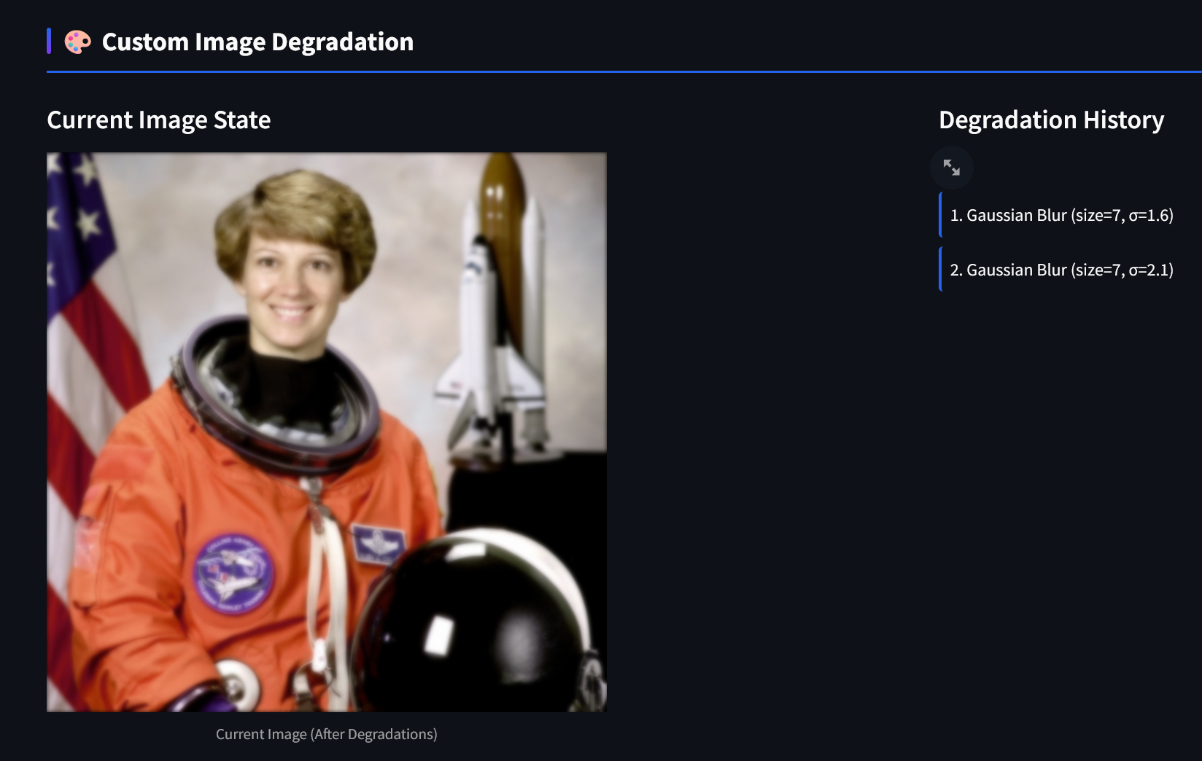
Implementation
Fig. 13: Gaussian Blur Added
Notes:
Contains 1000 images with complex backgrounds and low contrast objects along with their ground truth images

Slide 20
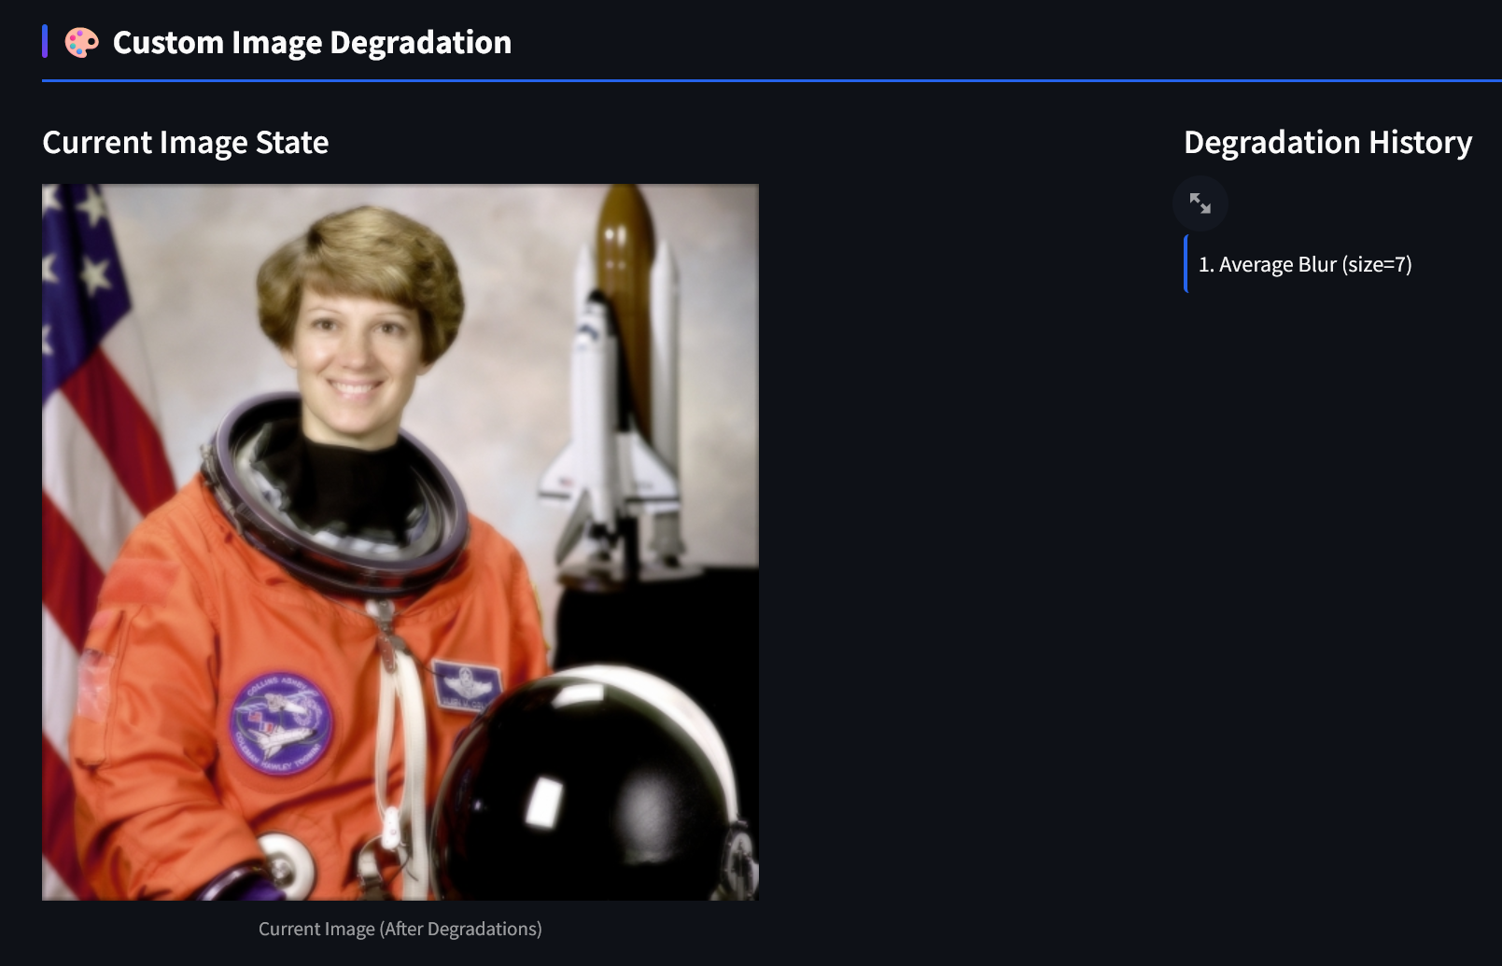
Implementation
Fig. 14: Average Blur Added
Notes:
Contains 1000 images with complex backgrounds and low contrast objects along with their ground truth images

Slide 21
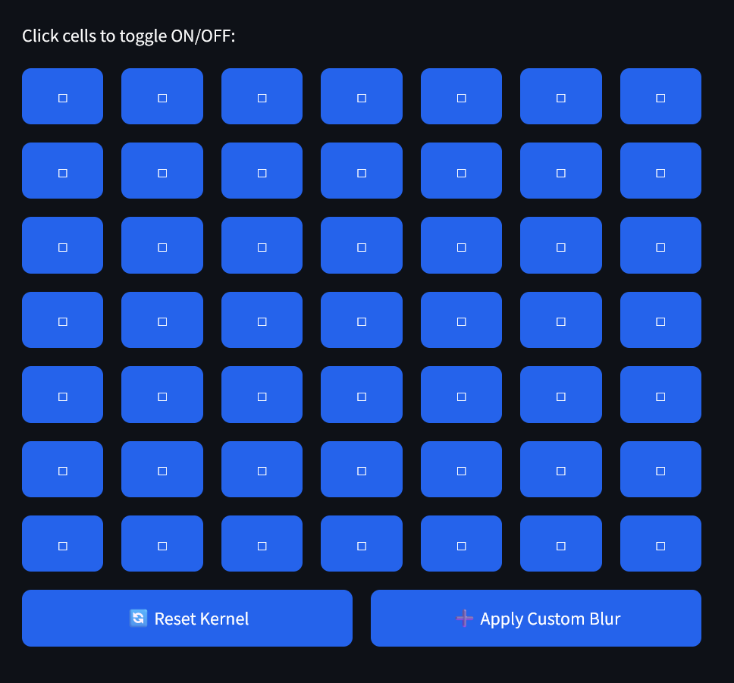
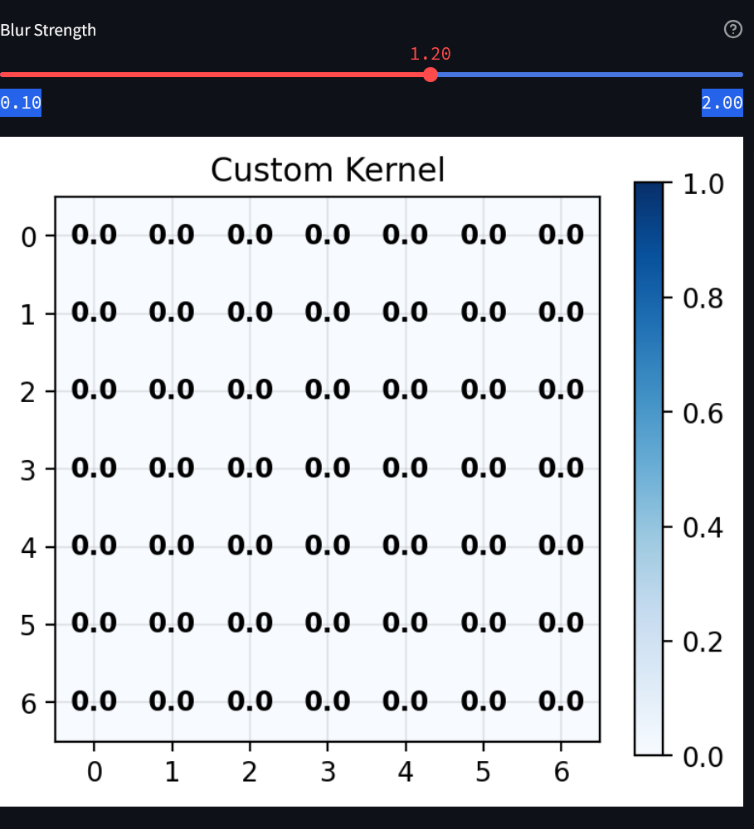
Implementation
Fig. 15: Custom Blur Kernel
Notes:
Contains 1000 images with complex backgrounds and low contrast objects along with their ground truth images

Slide 22
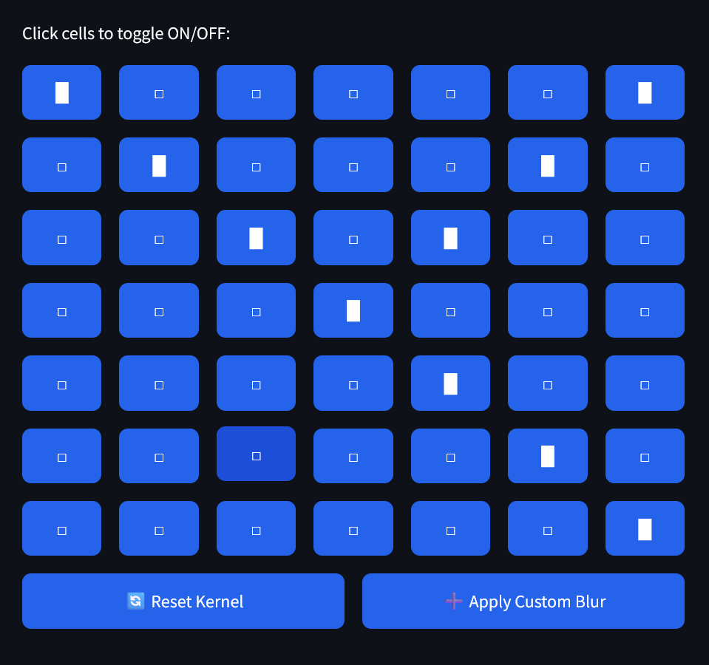
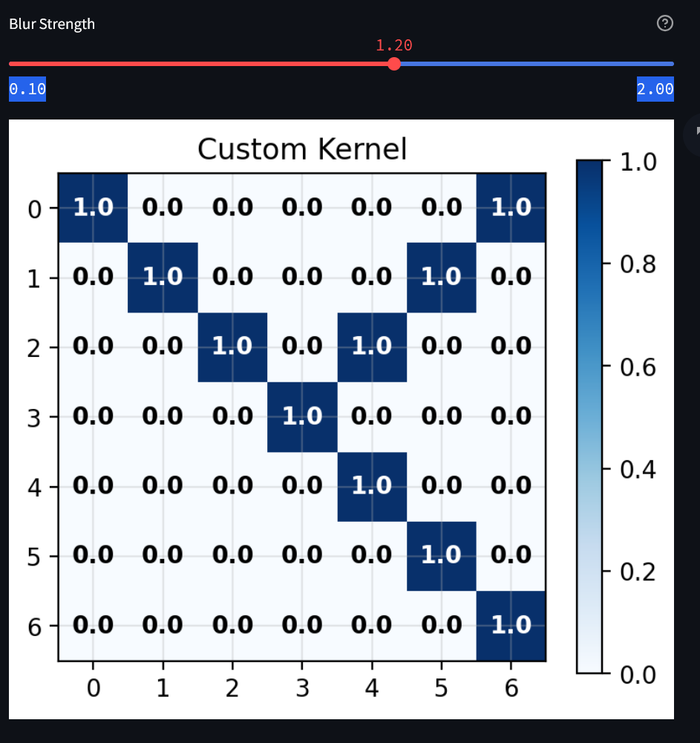
Implementation
Fig. 16: Custom Blur Kernel
Notes:
Contains 1000 images with complex backgrounds and low contrast objects along with their ground truth images

Slide 23
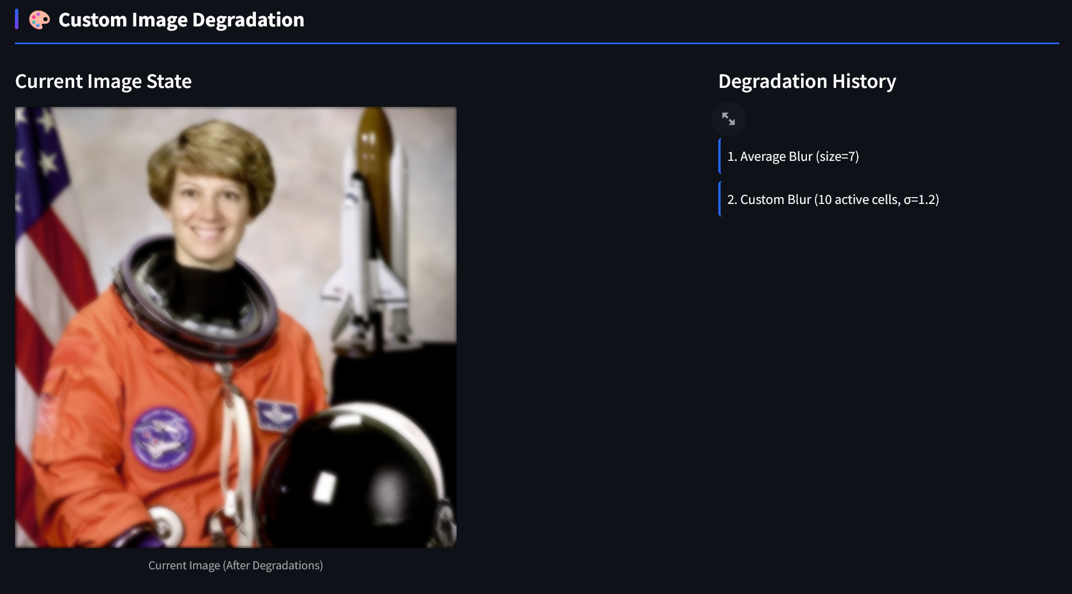
Implementation
Fig. 17: Custom Blur Added
Notes:
Contains 1000 images with complex backgrounds and low contrast objects along with their ground truth images

Slide 24
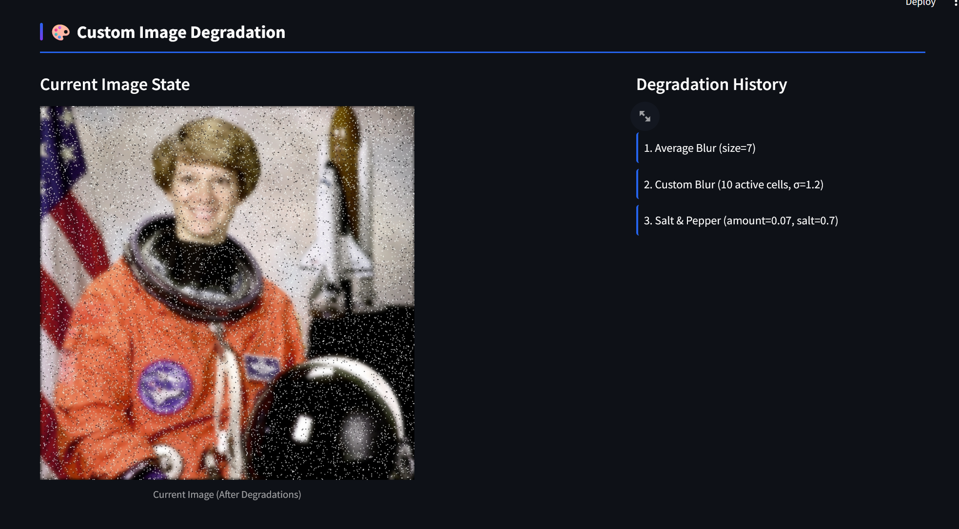
Implementation
Fig. 18: Blur + Salt & Pepper Noise Added
Notes:
Contains 1000 images with complex backgrounds and low contrast objects along with their ground truth images

Slide 25
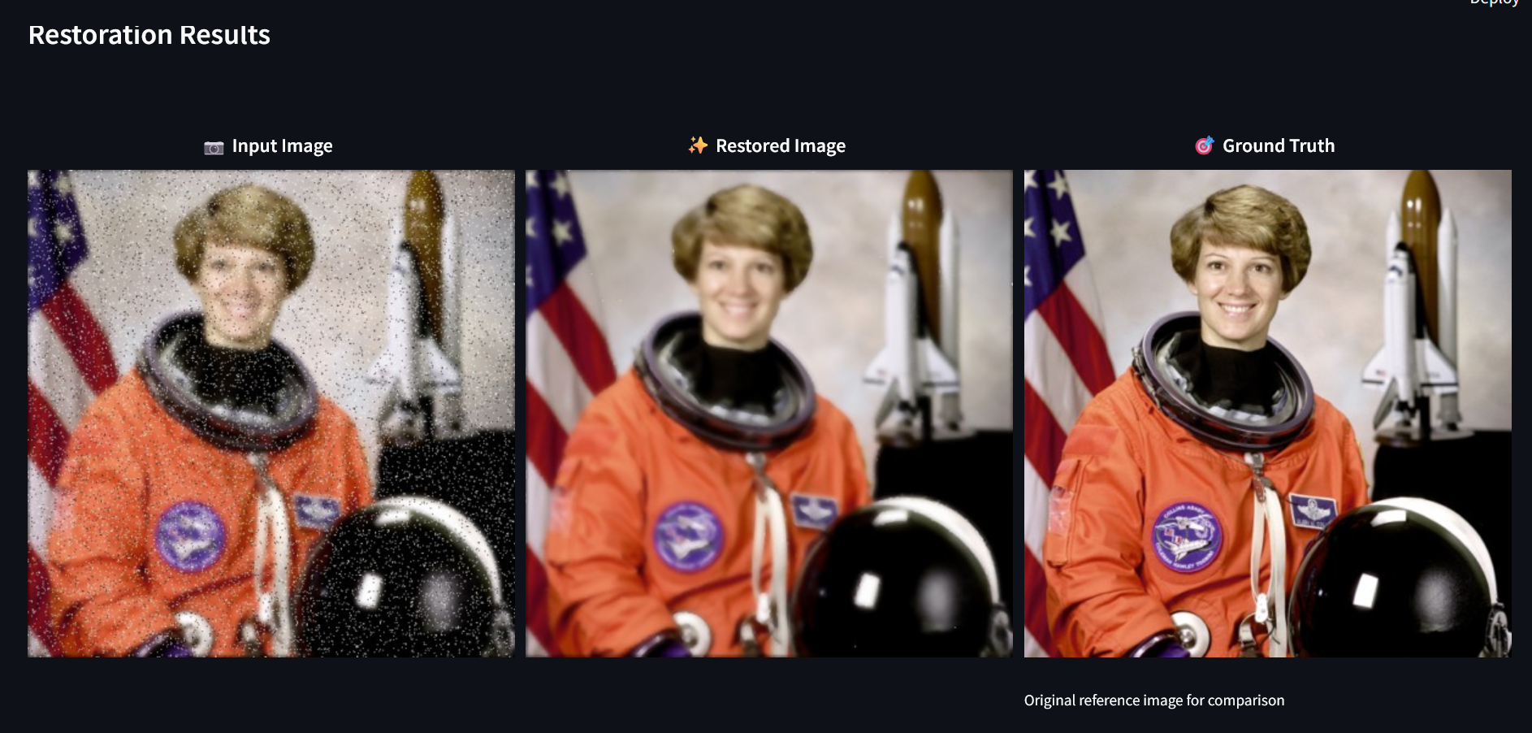
Implementation
Fig. 19: Restoration Results
Notes:
Contains 1000 images with complex backgrounds and low contrast objects along with their ground truth images

Slide 26
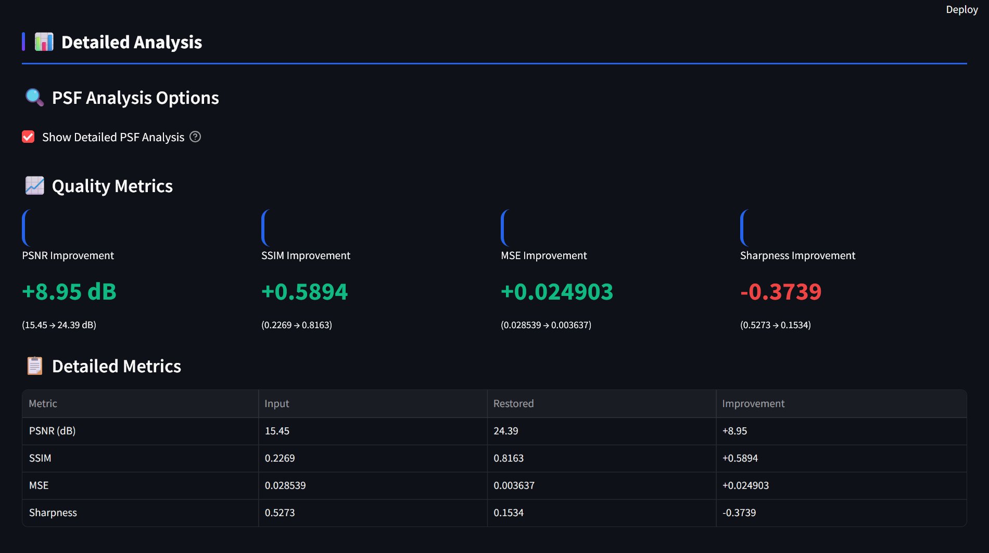
Implementation
Fig. 20: Quantitative Results
Notes:
Contains 1000 images with complex backgrounds and low contrast objects along with their ground truth images

Slide 27
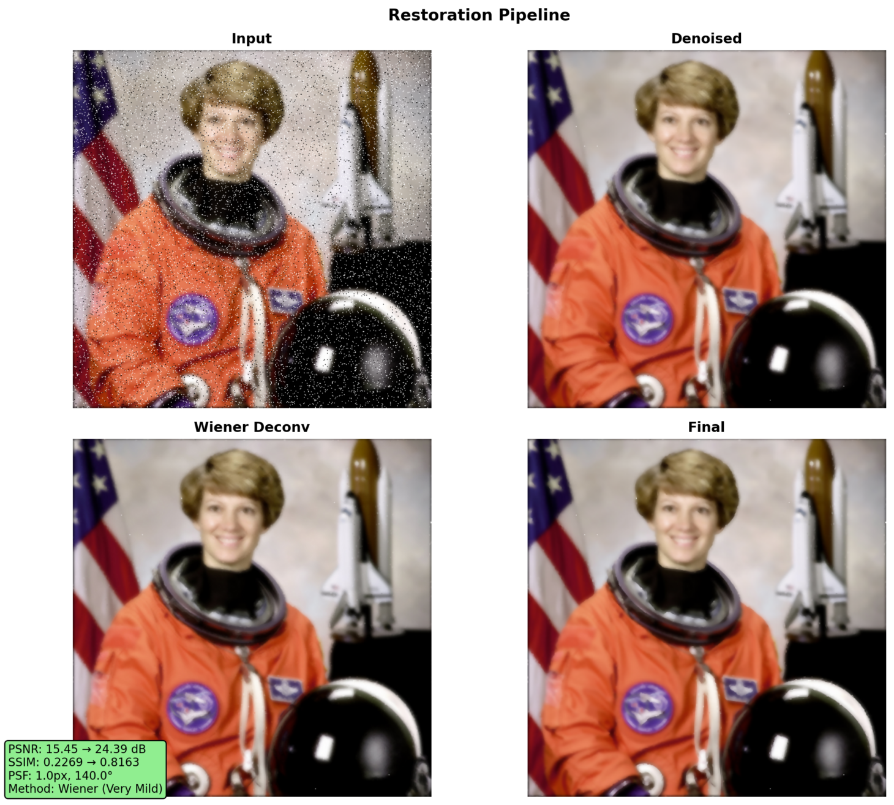
Implementation
Fig. 21: Intermediate Stages
Notes:
Contains 1000 images with complex backgrounds and low contrast objects along with their ground truth images

Slide 28
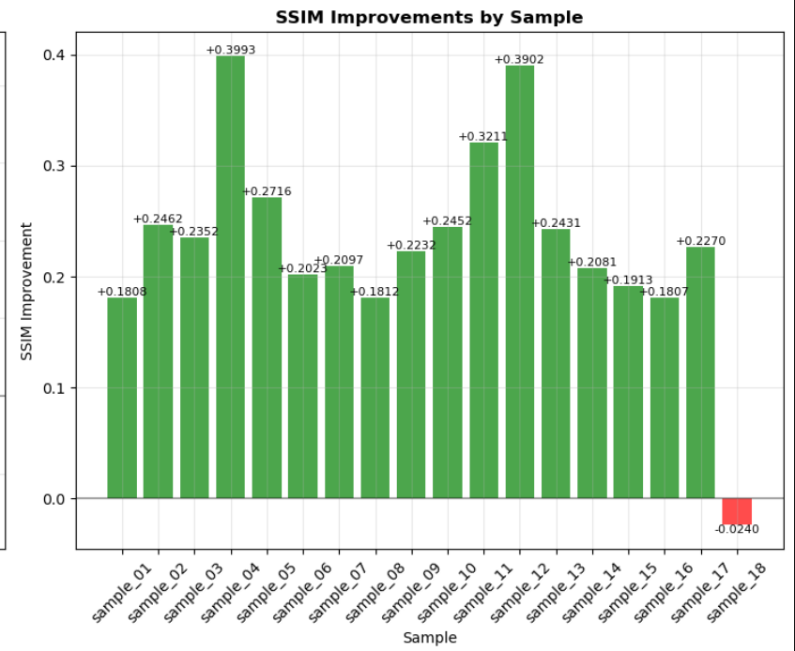
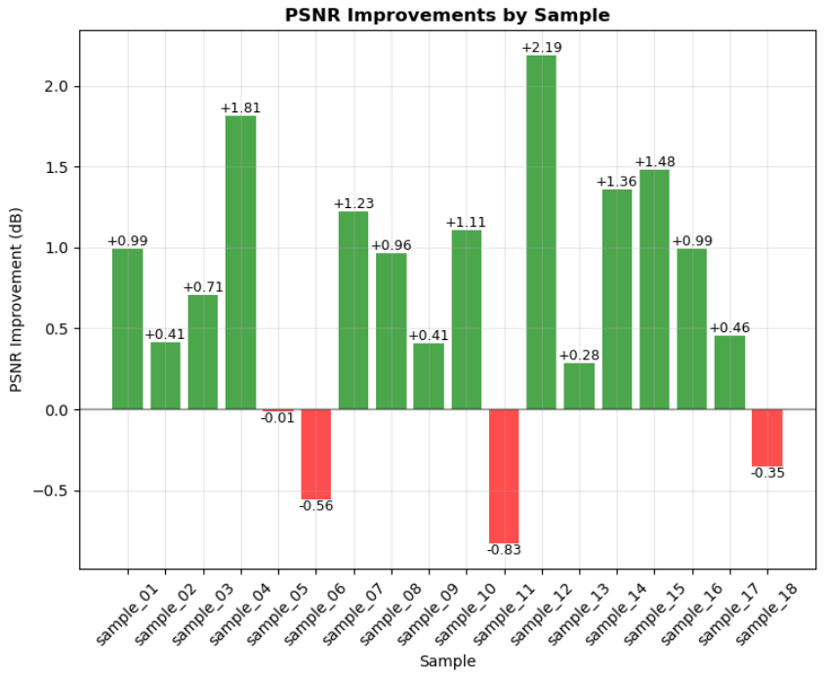
Results
Fig. 22: PSNR & SSIM Metrics on 18 image dataset

Slide 29
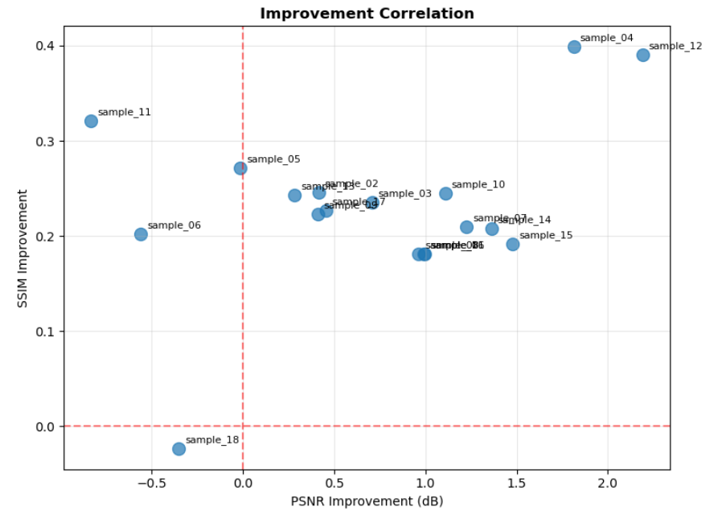
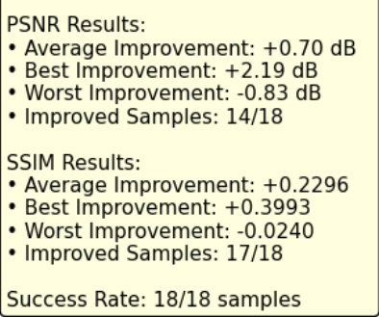
Results
Fig. 23: PSNR & SSIM Metrics on 18 image dataset

Slide 30
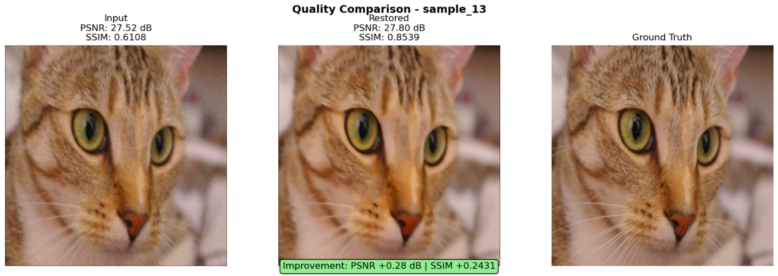
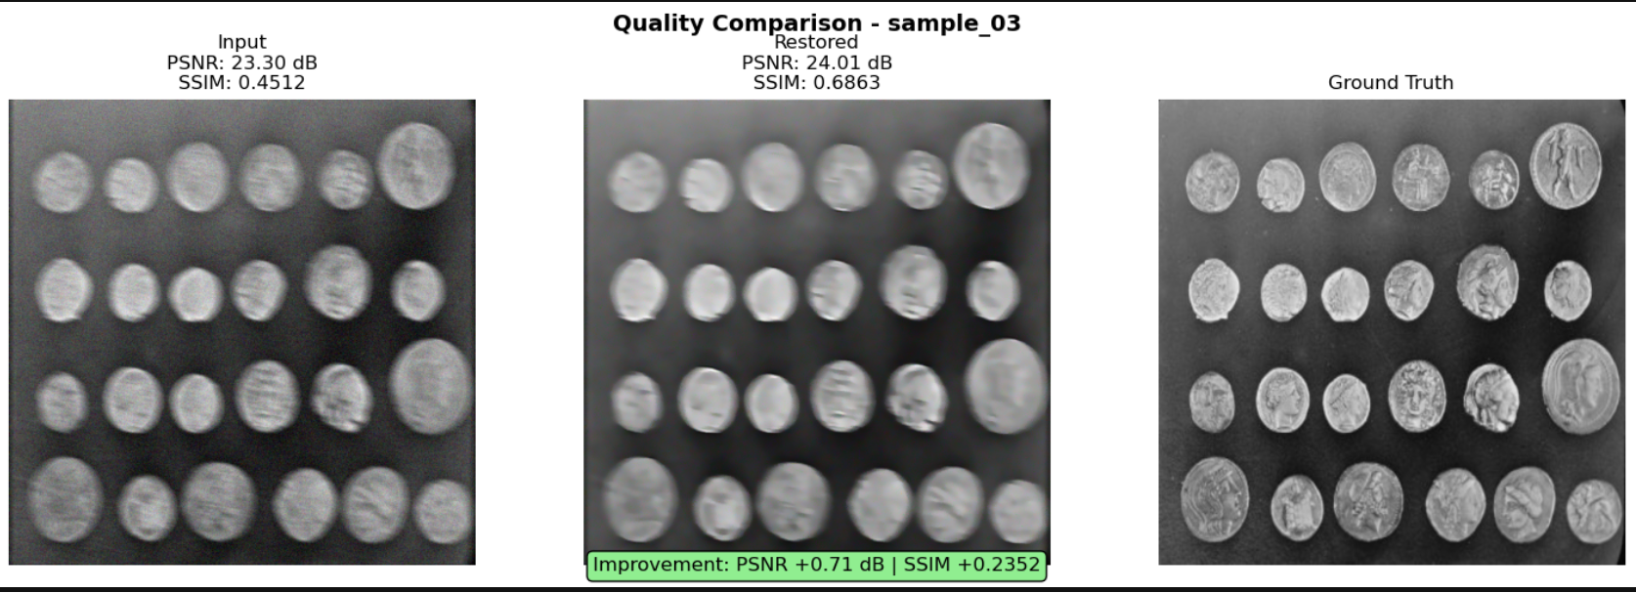
Discussion
Fig. 24: Qualitative
Results

Slide 31
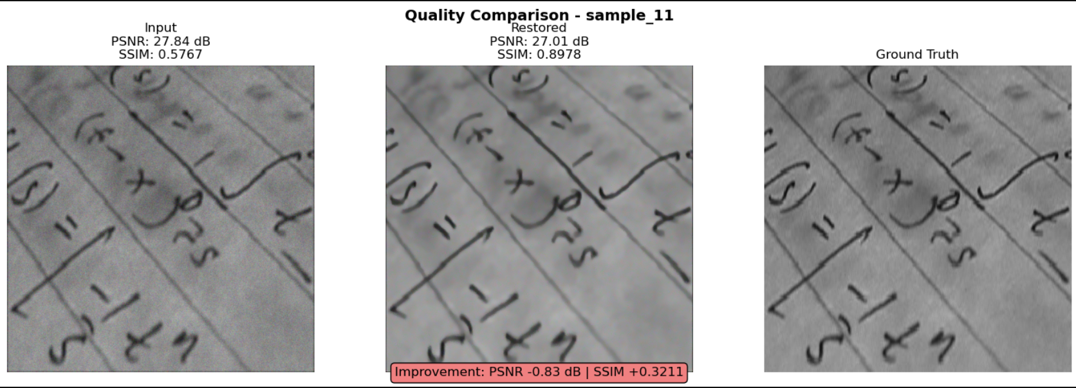
Discussion
Fig. 25: Only SSIM Improvement

Slide 32
Discussion
Adaptive parameter tuning helps to generalise for diverse images.
Multiple layer of restoration process improves the objective metrics like
PSNR or SSIM
If the image has severe blur or the huge amount of details then the pipeline struggles to improve the quality of the image.

Slide 33
Conclusions
Handles mixed degradations
Lower computational cost than deep learning
No training data required
Consistent improvement in objective metrics

Slide 34
Selected References
[1] K. Dabov, A. Foi, V. Katkovnik, and K. Egiazarian, "Image Denoising by Sparse 3-D Transform-Domain Collaborative Filtering,"
*IEEE Transactions on Image Processing*, vol. 16, no. 8, pp. 2080-2095, Aug. 2007.
[2] A. Levin, Y. Weiss, F. Durand, and W. T. Freeman, "Understanding and Evaluating Blind Deconvolution Algorithms,"
*IEEE Conference on Computer Vision and Pattern Recognition (CVPR)*, pp. 1964-1971, 2009.
[3] A. Buades, B. Coll, and J. M. Morel, "A Non-Local Algorithm for Image Denoising,"
*IEEE Conference on Computer Vision and Pattern Recognition (CVPR)*, vol. 2, pp. 60-65, 2005.
[4] Z. Wang, A. C. Bovik, H. R. Sheikh, and E. P. Simoncelli, "Image Quality Assessment: From Error Visibility to Structural Similarity,"
*IEEE Transactions on Image Processing*, vol. 13, no. 4, pp. 600-612, Apr. 2004.

Slide 35
Thank You

